Slide 1
Web Development Project : Knowledge Hub.
Here is where your presentation begins

Slide 2
Team Members : --
Pritam Choudhary : IIT2023102
Daksh Bhatti : IIT2023099
Saumya Agarwal : IIT2023098
Mukesh Samardha Ginni : IIT2023070

Slide 3
Motivation :
01
02
03
04
05
06
Awareness
Authenticity
User Friendly
Knowledge
Simple and user friendly
For a Better Future.

Slide 4
Objective Statement : --
The People Nowadays don’t get Authentic News So, This will help them to get Authentic News in Cleaner Way so That People Will Gain the Authentic Knowledge, Website has a friendly interface(which is missing in most websites) so that they enjoy being on the site.

Slide 5
Technology Used : --
We Have Used Various Technology to make our website dynamic. A Great Work in done on User Interface So that People enjoy Scrolling on this Website.
HTML
CSS
JAVASCRIPT
NODE JS
MIDDLEWARES
MONGODB
FETCHING API
ETC…..

Slide 6
Conclusion :--
We Came with a Website Which Provide Authentic and Cleaner News with Details of every Aspects.
Our Website is Dynamic, Which Gives Current Happening Around the World.
User friendly Interface so That People Visit Frequently and Spent most of the time there.
This Website Will Set Standard for News / Information site.

Slide 7
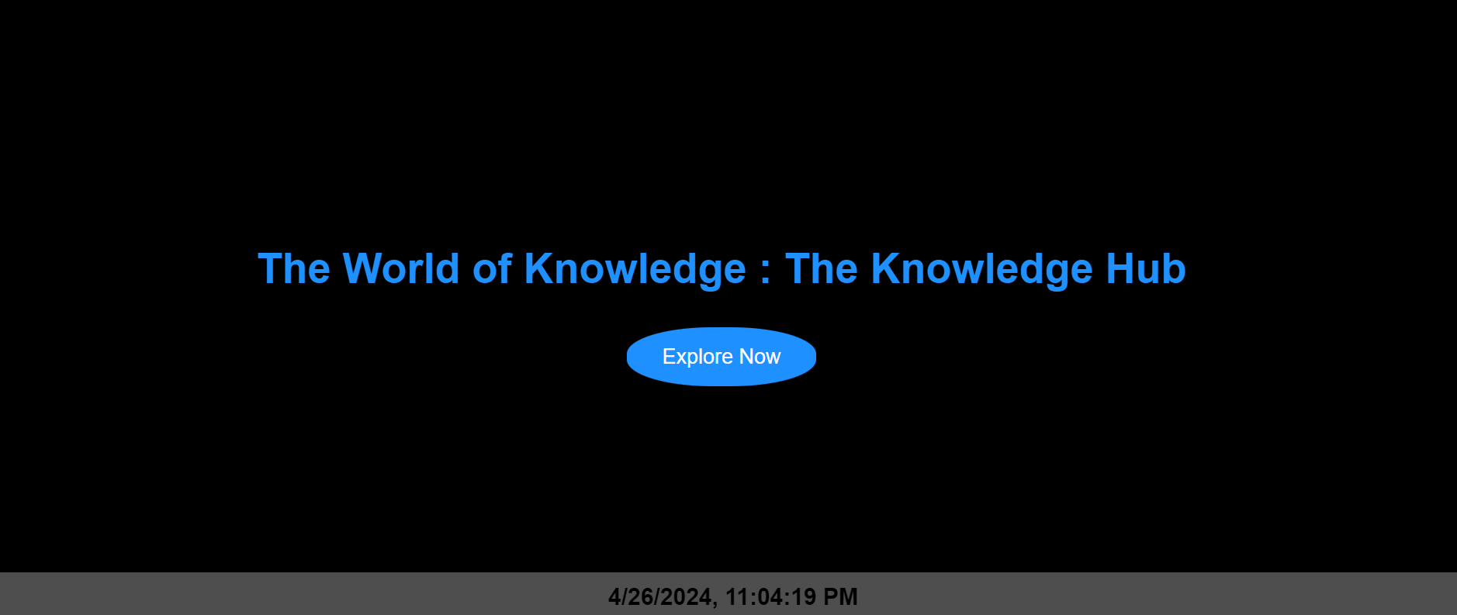

Slide 8
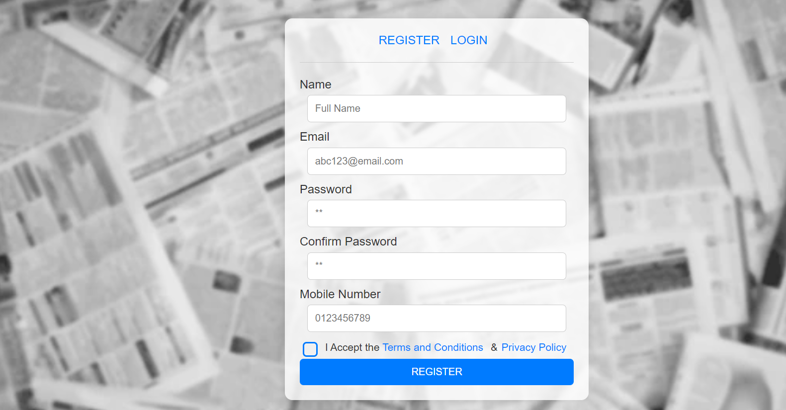

Slide 9
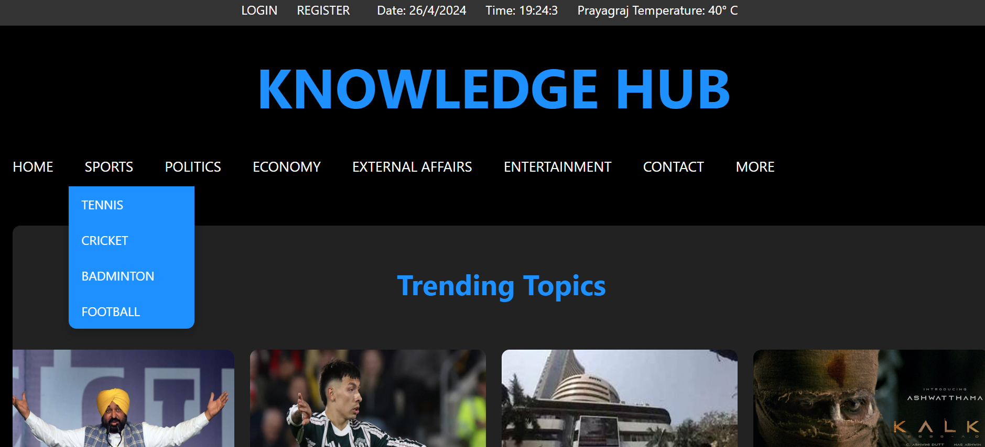

Slide 10
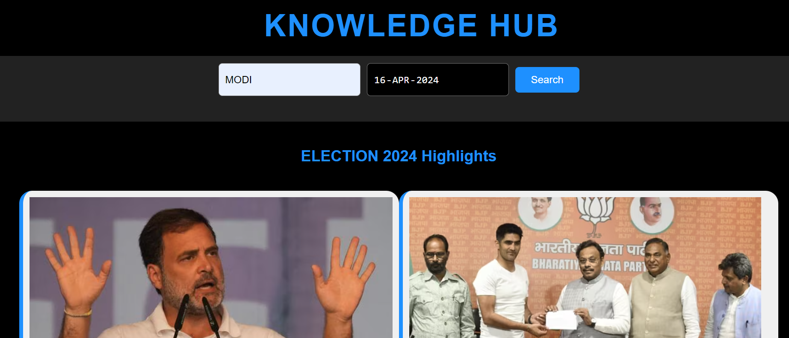

Slide 11
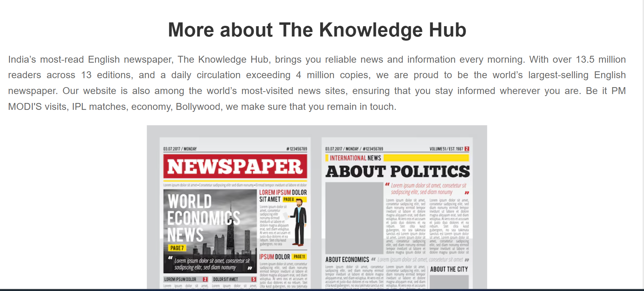

Slide 12
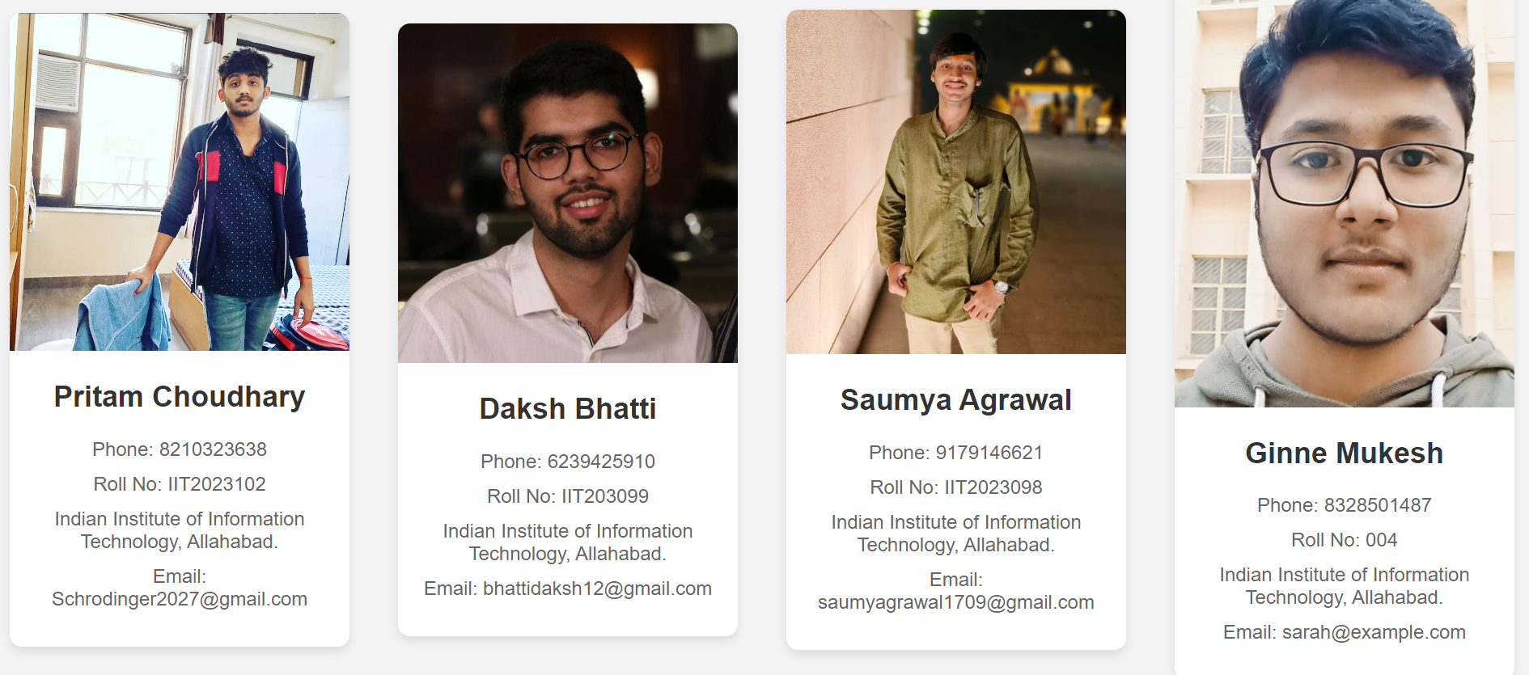

Slide 13
THANK YOU FROM ALL TEAM MEMBERS!

